Slide 1
Demo: Movie Recommendations
Group 4: Alessia Simone, Berk Gönenç, Hannah George, Julia Le, Thorsten Kalb

Slide 2


Obtain data and store it
Download the data from Movielens, look at them and decide to merge together.
Demo: https://files.grouplens.org/datasets/movielens/ml-latest-small.zip
Final: https://files.grouplens.org/datasets/movielens/ml-latest.zip
LINK
MOVIE
RATINGS
TAGS

Slide 3
Merge the data in one table
Only one merged table for all the data.
LINK
MOVIE
RATINGS
TAGS
LINK + MOVIE + RATINGS + TAGS

Slide 4

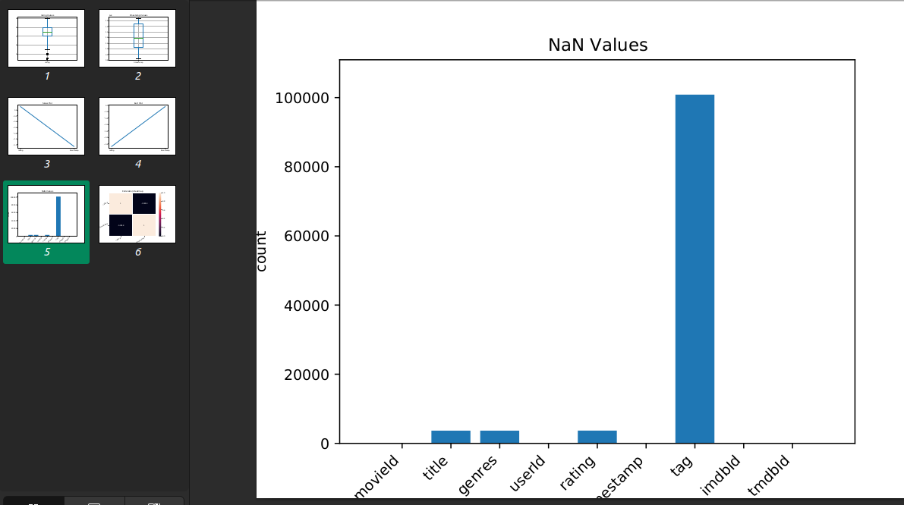
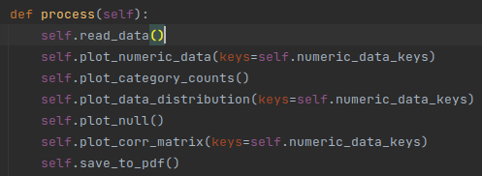
Visualization for the Data Analyst
Plotted
Merged_data
Some code

Slide 5
Clean the data in order to develop a recommender
Tasks
Deal with categorical data (encode)
Select relating / relevant features
Normalize the data
Removed
Misunderstanding

Slide 6
Comparison of Recommenders for Developer
Compared three models: pooling, cnn, and lstm
Pooling
Mrr validation score= 0.0415
Average first relevant movie is at place 278.9352038996552
CNN
Mrr validation score= 0.0444
Average first relevant movie is at place 327.1417191772679
LSTM
Mrr validation score= 0.0131
Average first relevant movie is at place 713.9399595767447

